Slide 1
Object Oriented Principles in Java

Slide 2
Outline
Review of object-oriented principles
Super class, sub class, inheritance, and member access
Types of inheritance
Extends and super keyword
Overriding/Overloading
Final classes and methods
Abstract classes and methods
Upcasting vs Down casting
Interfaces and Implementations

Slide 3
Review of object-oriented programming
Object-Oriented Programming Principle is the strategy or style of developing applications based on objects.
Anything in the world can be defined as an object. And in the OOPs, it can be defined in terms of its properties and behavior.
In short, it is a programming methodology that has certain principles and with the help of these principles, the software is developed.

Slide 4
Components of Object-Oriented Programming
Objects – Object is the entity that makes the classes to be implemented into the program. It makes the features, properties, and behaviors of the class to be implemented. Example – A car is an object that has property color, model, brand name, fuel type, etc, and behaviors like, it runs. So these properties and behavior make an object (CAR).
Classes – A class can be stated as the blueprint of the object. This states what an object can do. It contains all the features, attributes, and behavior of what the model can do. We can say that class contains the definition of the object. Example – Car color, engine type, etc. And with the definition, we can create any number of objects.
Methods – Methods are the attributes of the class which are defined for the specified behavior of the object. It can also modify the state of the class. Example – Method to drive a car, It changes the state of the car from parking state to running state.
Instances – It is the members of the class who holds some values related to the objects of the class

Slide 5
OOP principles
Object-Oriented Principles mainly include the 4 pillars that together make the OOP a very powerful concept
Abstraction
Encapsulation
Inheritance
Polymorphism
OOP is based on real-life engineered things
The design approaches followed their, the same replicated to the software engineering with the concept of these 4 Object-Oriented Programming principles.

Slide 6
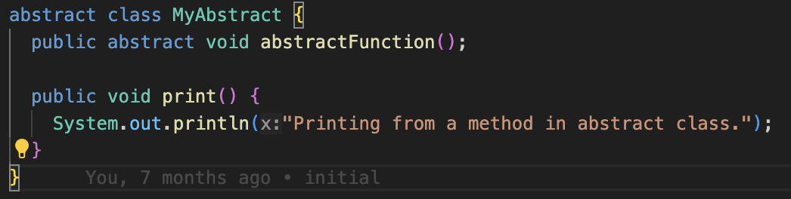
Abstraction
Abstraction can be defined as hiding internal implementation and showing only the required features or set of services that are offered.
This is the most essential part of Object-Oriented programming.

Slide 7
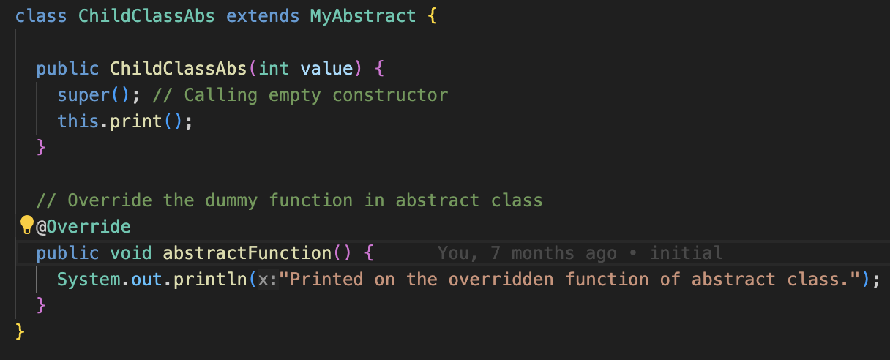
Abstract (contd...)

Slide 8
Encapsulation
Encapsulation can be defined as the binding of data and attributes or methods and data members in a single unit.
Encapsulation = Data Hiding + Abstraction.
Features of Encapsulation –
It provides extra security by the concept of Data Hiding.
It groups the data and operation in that data into a single unit.
It attaches an extra security layer to the data and allows to access data only to authorized ones.

Slide 9
Polymorphism
Polymorphism is the most essential concept of the Object-Oriented Programming principle. It has meaning ‘poly’ – many, ‘morph’ – forms. So polymorphism means many forms.
Compile Time Polymorphism is achieved using Method Overloading: When more than one method is declared with the same name but with a different number of parameters or different data-type of parameter, that is called method overloading.
Runtime polymorphism is achieved using Method Overriding: When more than one method is declared as the same name and same signature but in a different class. Then the derived class method will override the base class method. This means the Base class method will be shadowed by the derived class method

Slide 10
Inheritance
Inheritance is the method of acquiring features of the existing class into the new class.
Suppose there is a class, considered as the parent class, that has some methods associated with it. And we declare a new class, considered as the child class, that has its own methods. So, when a child class is inherited from the parent class then it will have all the methods associated with parent class are available in the child class along with the child class own methods also. So that is Inheritance

Slide 11
Types of Inheritance
Single Inheritance – When there is only one derived class.
Multiple Inheritance – When child class is inheriting more than one base class.
Multilevel Inheritance – When there is a level of inheritance. From class A to class B to class C.
Hierarchical Inheritance – When more than one derived class is inheriting one base class.

Slide 12
Super class, sub class
It is possible to inherit attributes and methods from one class to another.
We can group the "inheritance concept" into two categories:
subclass (child) - the class that inherits from another class
superclass (parent) - the class being inherited from

Slide 13
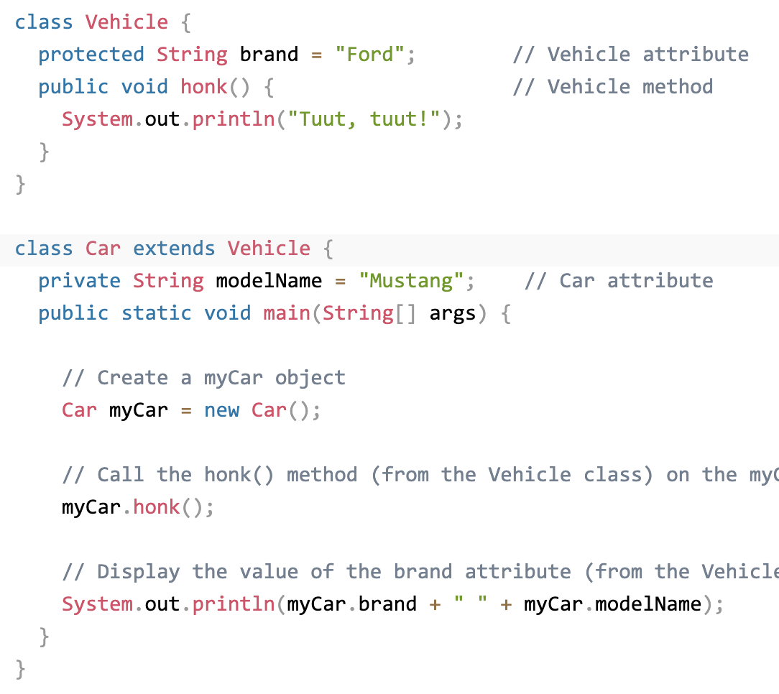

Slide 14
Extends and super keyword
The extends keyword is used in class declarations or class expressions to create a class that is a child of another class.
The constructor body of a derived class (with extends), the super keyword may appear as a "function call" (super(...args)), which must be called before the this keyword is used, and before the constructor returns.

Slide 15
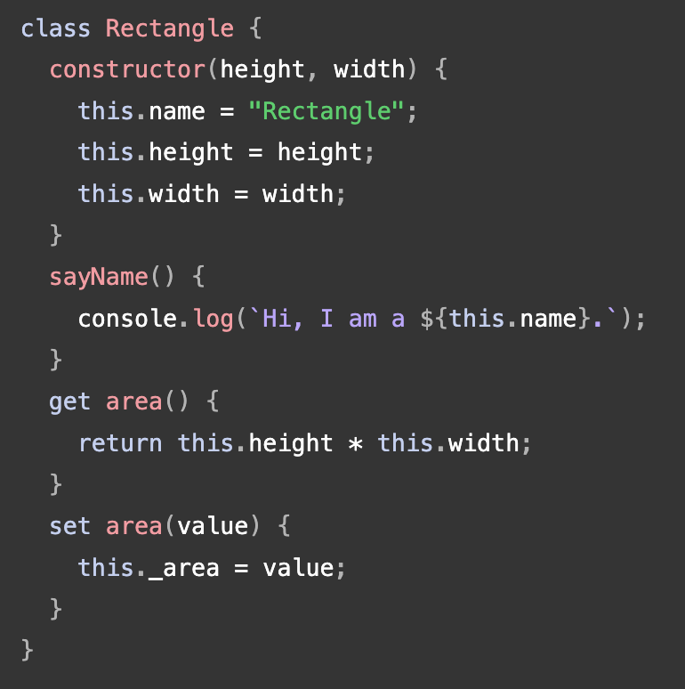
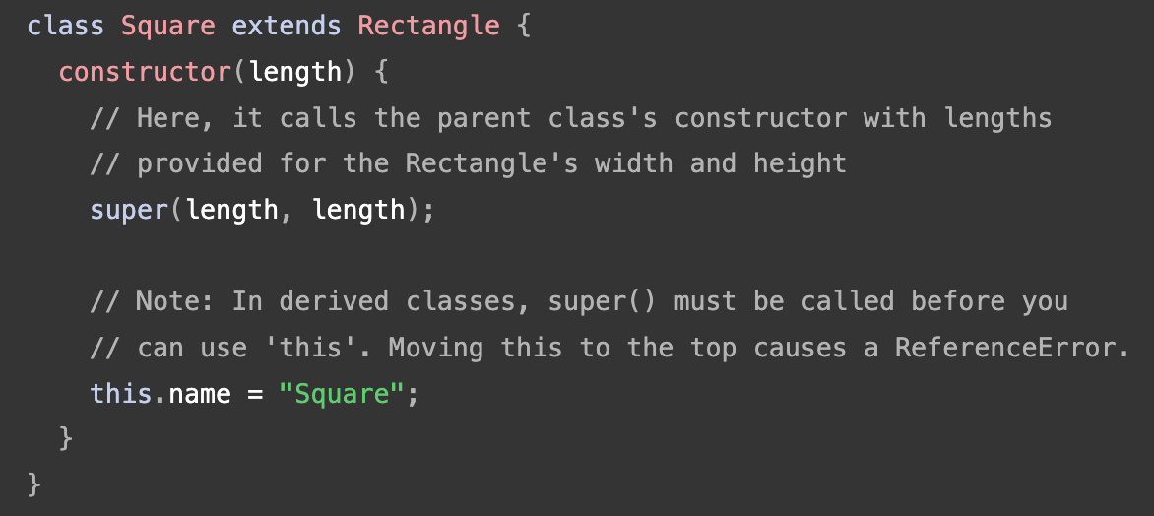
PARENT CLASS
CHILD CLASS

Slide 16
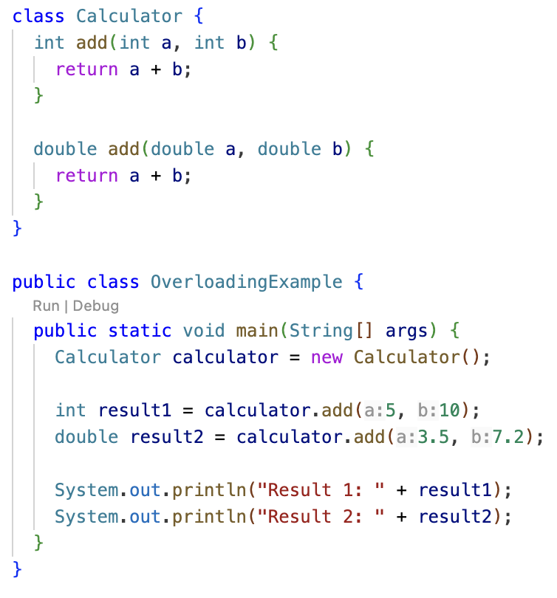
Method Overloading

Slide 17
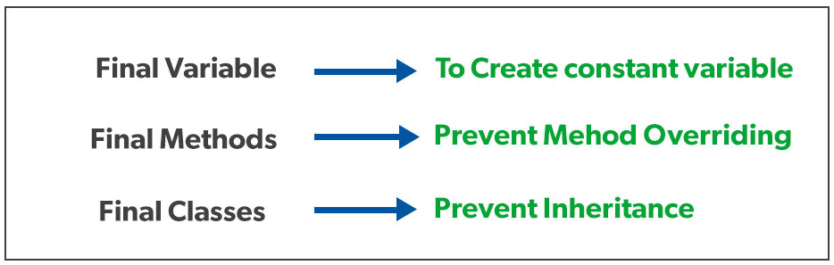
Final classes and methods
final keyword is used in different contexts.
First of all, final is a non-access modifier applicable only to a variable, a method, or a class.

Slide 18
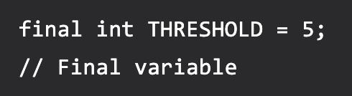
Final Variable
When a variable is declared with the final keyword, its value can’t be modified, essentially, a constant.
This also means that you must initialize a final variable
If the final variable is a reference, this means that the variable cannot be re-bound to reference another object, but the internal state of the object pointed by that reference variable can be changed
It is good practice to represent final variables in all uppercase, using underscore to separate words.

Slide 19
There are three ways to initialize a final variable:
You can initialize a final variable when it is declared. This approach is the most common. A final variable is called a blank final variable if it is not initialized while declaration. Below are the two ways to initialize a blank final variable.
A blank final variable can be initialized inside an instance-initializer block or inside the constructor. If you have more than one constructor in your class then it must be initialized in all of them, otherwise, a compile-time error will be thrown.
A blank final static variable can be initialized inside a static block.

Slide 20
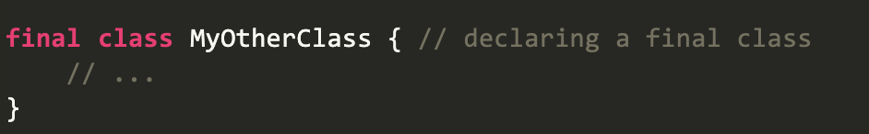
Final Class
When a class is declared with final keyword, it is called a final class. A final class cannot be extended(inherited).
There are two uses of a final class:
Usage 1: One is definitely to prevent inheritance, as final classes cannot be extended
Usage 2: The other use of final with classes is to create an immutable class like the predefined String class.

Slide 21
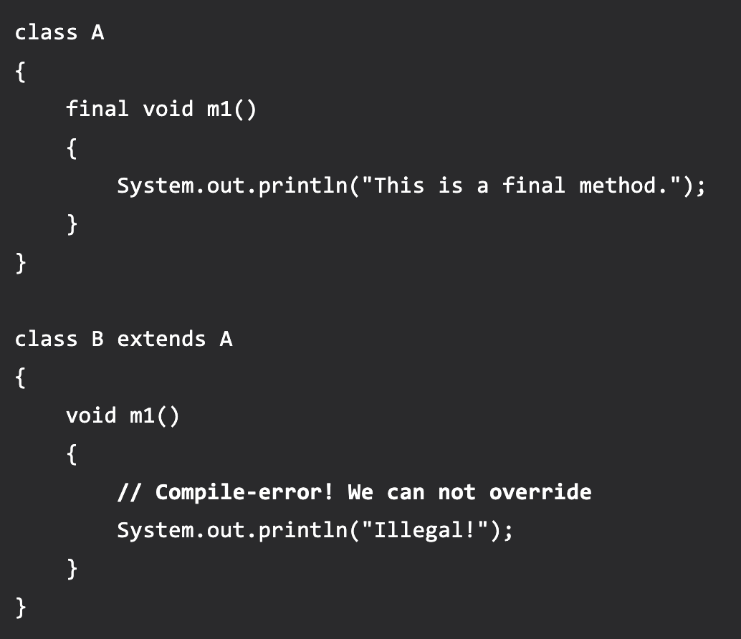
Final Methods
When a method is declared with final keyword, it is called a final method. A final method cannot be overridden.
We must declare methods with the final keyword for which we are required to follow the same implementation throughout all the derived classes.

Slide 22
Abstract classes and methods
The abstract keyword is a non-access modifier, used for classes and methods:
Abstract class: is a restricted class that cannot be used to create objects (to access it, it must be inherited from another class).
Abstract method: can only be used in an abstract class, and it does not have a body. The body is provided by the subclass (inherited from)

Slide 23
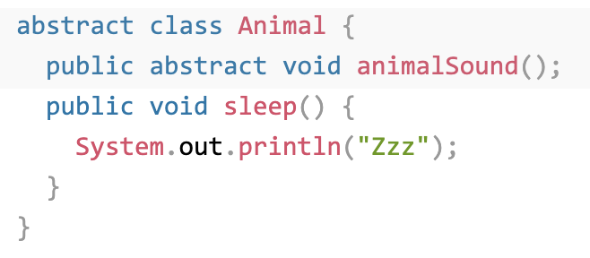
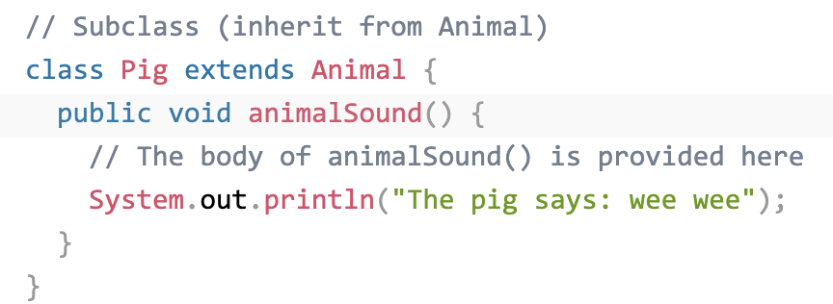
❌

Slide 24
Upcasting vs Down casting
A process of converting one data type to another is known as Typecasting
Upcasting and Downcasting is the type of object typecasting
In Java, the object can also be typecasted like the datatypes
So, there are two types of typecasting possible for an object, i.e., Parent to Child and Child to Parent or can say Upcasting and Downcasting.

Slide 25
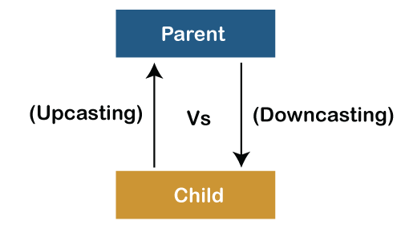
Upcasting vs Down casting (contd...)
Typecasting is used to ensure whether variables are correctly processed by a function or not
In Upcasting and Downcasting, we typecast a child object to a parent object and a parent object to a child object simultaneously.
We can perform Upcasting implicitly or explicitly, but downcasting cannot be implicitly possible.

Slide 26
S.No | Upcasting | Downcasting
1. | A child object is typecasted to a parent object. | The reference of the parent class object is passed to the child class.
2. | We can perform Upcasting implicitly or explicitly. | Implicitly Downcasting is not possible.
3. | In the child class, we can access the methods and variables of the parent class. | The methods and variables of both the classes(parent and child) can be accessed.
4. | We can access some specified methods of the child class. | All the methods and variables of both classes can be accessed by performing downcasting.
5. | Parent p = new Child() | Parent p = new Child() Child c = (Child)p;

Slide 27
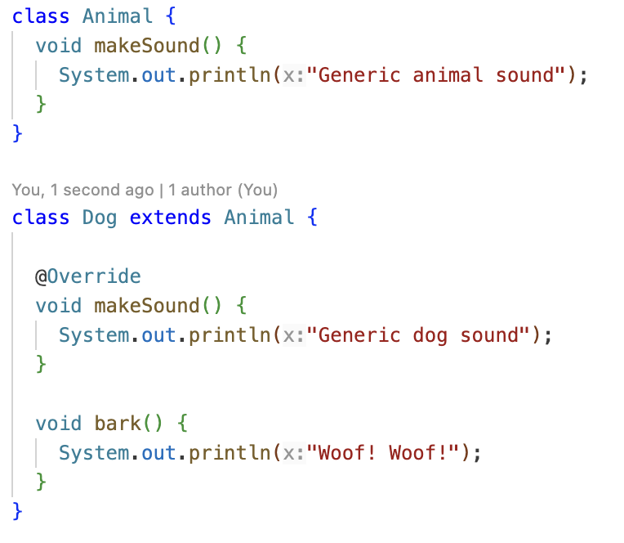

Slide 28
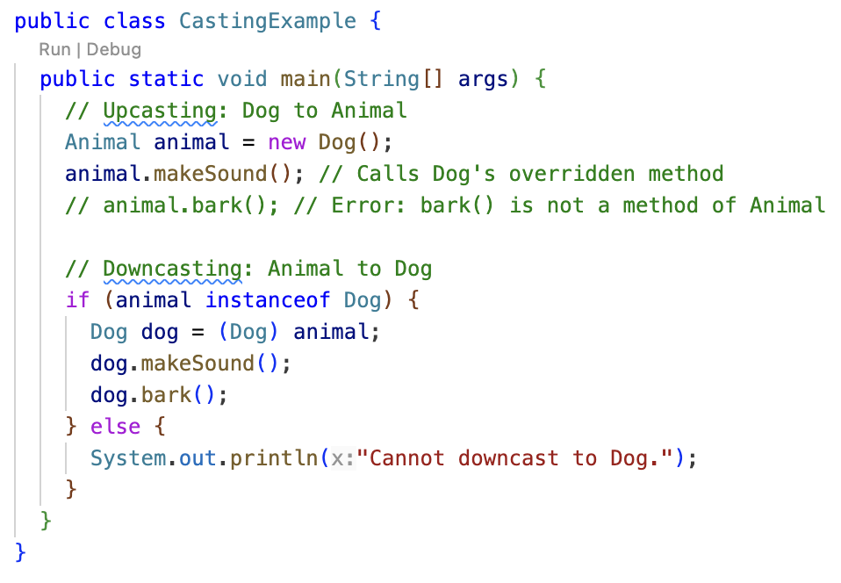

Slide 29
In this example:
Dog is a subclass of Animal.
makeSound() is a method in both Animal and Dog, but bark() is specific to Dog.
The main method demonstrates upcasting by creating a Dog object and assigning it to an Animal reference.
While upcasted, the animal reference can only access methods declared in the Animal class.
To access bark() (a Dog-specific method), downcasting is used. We check if the object is an instance of Dog before downcasting to avoid runtime errors.
If the object is a Dog, we perform the downcast and access both the overridden makeSound() and bark() methods.

Slide 30
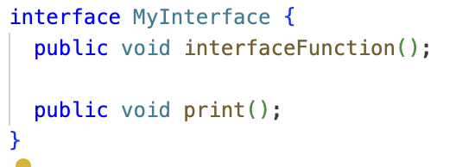
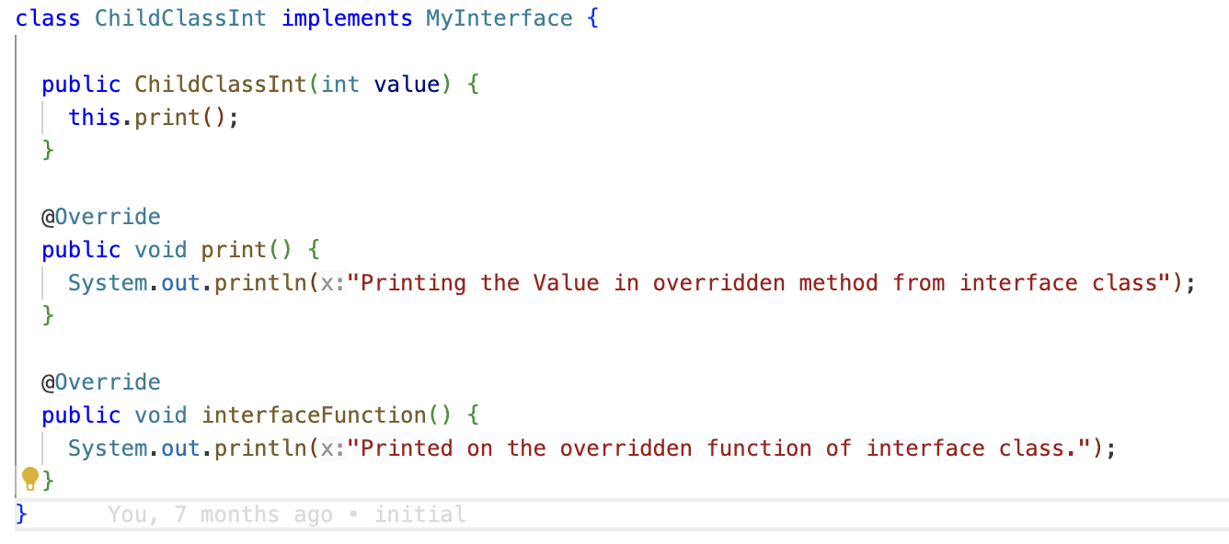
Interfaces and Implementations

Slide 31
Thank You

